Slide 1
Javascript 101 – Coding Practice
CCAPDEV
Web Application Design & Development

Slide 2
Activities
My Mini-Gallery
Form Validation
Rock-Paper-Scissors

Slide 3
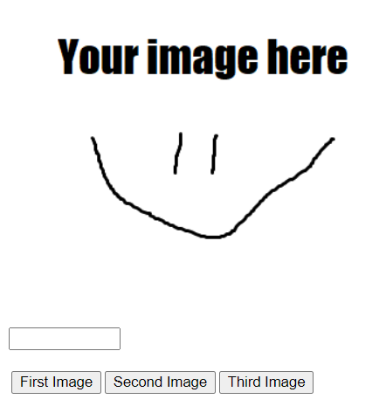
Activity #1 – My Mini-Gallery
1_gallery.html

Slide 4
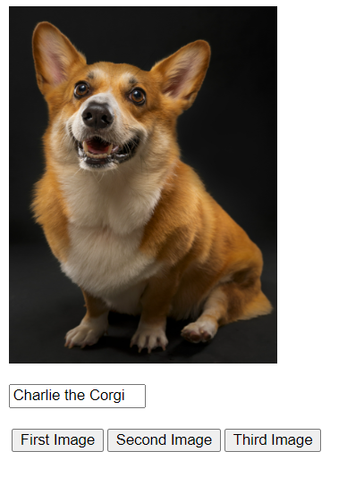
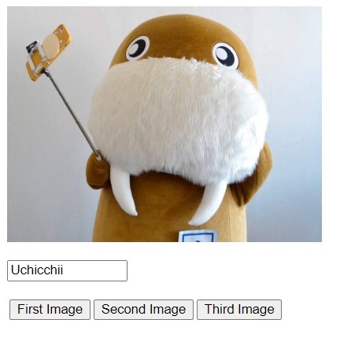
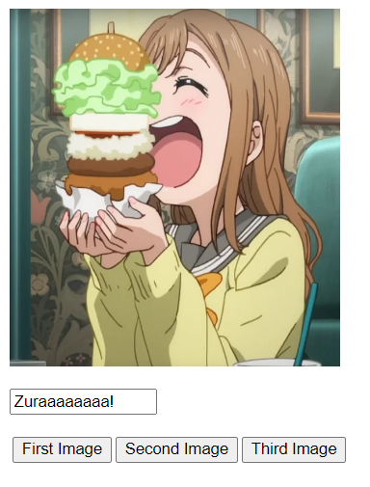
Activity #1 – My Mini-Gallery
Display 3 different images (of your own choosing) with different captions for each button pressed.

Slide 5
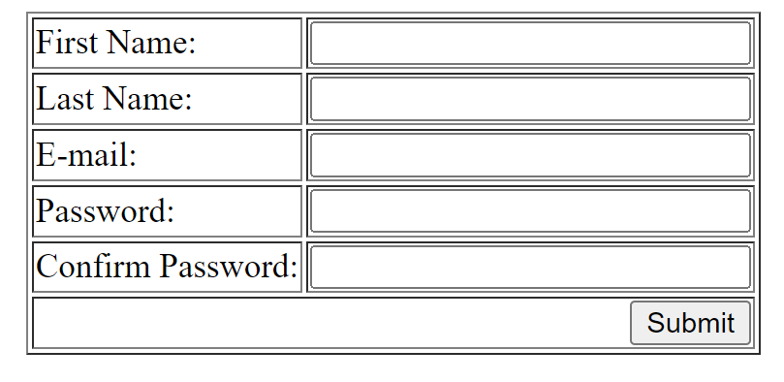
Activity #2 – Form Validation
2_form.html

Slide 6
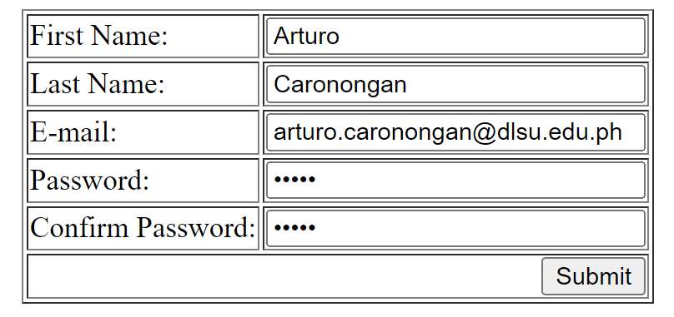
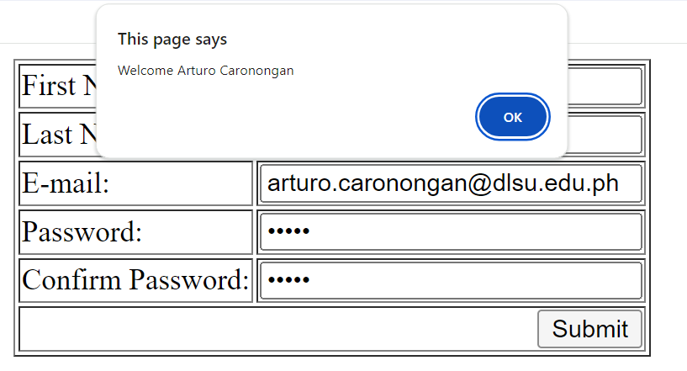
Activity #2 – Form Validation
A simple form application
When every entry is filled properly, greet the user via their full name (First + Last Name) then redirect the user to google.com

Slide 7
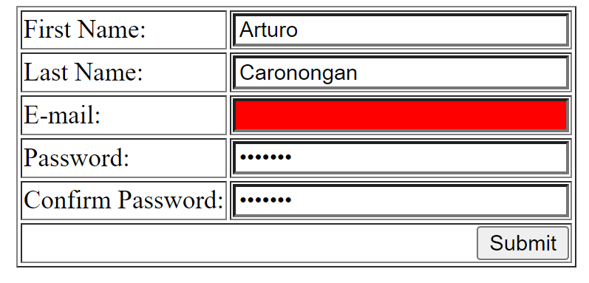
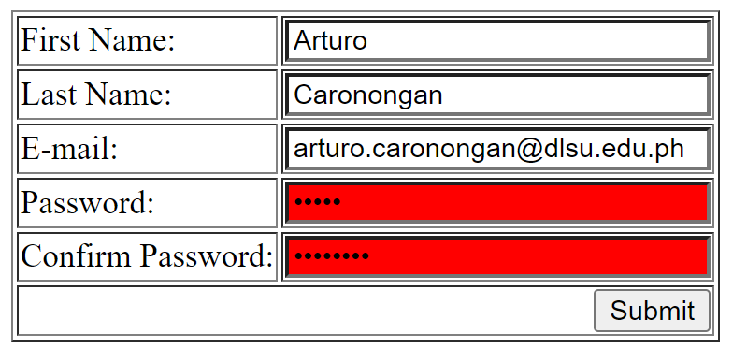
Activity #2 – Form Validation
Otherwise:
Highlight empty fields with the color red
Highlight both password fields with the color red if they do not match

Slide 8
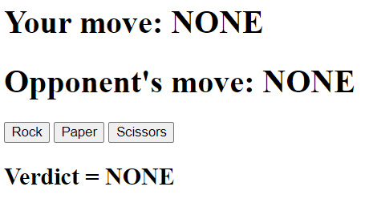
Activity #3 – Rock, Paper, Scissors!
3_rps.html

Slide 9
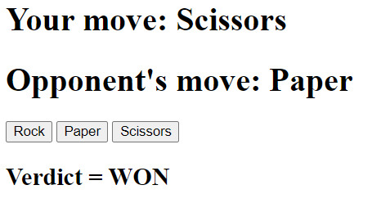
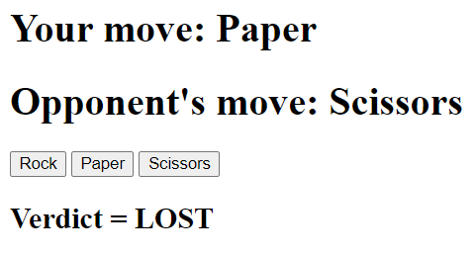
Activity #3 – Rock, Paper, Scissors!
Create a very simple “Rock-Paper-Scissors” Text-based game
Be as creative as you want with this! Add images, points, etc.

Slide 10
Submission
NO SUBMISSION NEEDED
However, when you finish an activity, raise your hand so I can take a look at it
Make sure to put these codes aside. They will come in handy and will be useful in the future. ☺

Slide 11
IMPORTANT DATES
Mini Challenge #1:
Week 5
Feb 5, 2026 (S18 & S19), Feb 6, 2026 (S20, S21)
HTML & CSS
MCO1 Demo:
Week 6
Feb 12, 2026 (S18 & S19), Feb 13 2026 (S20, S21)

